Slide 1

Concepts of Scoring
Training
4th / 5th June 2024 by
APDS Consulting
www.apds-analytics.com

Slide 2

Scorecard Training
Agenda
Introduction
Credit Analytics and Scoring Concepts
Decision Areas
  Origination
  Behavioural
  Credit Propensity
Modelling Steps 1 & 2 (includes a brief discussion on Reject Inference)
  Sampling
  Segmentation
  Characteristic Selection
  Characteristic Classing
  Modelling
    Traditional Regression Methods
    Tree Based Models (Decision Trees / Random Forests)
    ML Techniques
  Scorecard Scaling
Modelling and AI
Model Diagnostics & Validation
  Score Level – PSI, Gini, KS & Rank Ordering
  Characteristic Analysis
Other Risk Model Issues
  IRB / IFRS 9 PD, EAD & LGD
Model Risk Considerations
  Model Lifecycle
  Model Management Framework
  Model Inventory
  Approval Networks / Committees
Conclusions

Slide 3


APDS Consulting - Matthew Freeman Biography
Matthew has twenty plus years retail financial services industry experience, predominantly within the analytical risk management sphere, covering diverse geographies ranging from the United Kingdom and Western Europe, throughout the Middle East and India, China, Asia (North and across the South East) and Australasia (Australia and New Zealand).
Much of this experience has been gained within the big credit risk consulting firms (such as Experian and FICO) and with large banking and finance groups (such as Lloyds, Barclays, United Overseas Bank and GE Capital), developing both operational (supervised segmented application and behavioural scorecards (incorporating statistical and business oriented segmentation), built utilising linear or logistic regression) and regulatory (Basel II & IFRS9 PD, EAD and LGD) models, utilising a wide range of internal and external datasources (which have undergone detailed and specific quality checks to ensure that they are fit for the modelling / analytical purpose for which they are intended). Models and associated strategies have been developed for all the major consumer product groups such as cards, loans and mortgages.
More recently he has started to consider how the new, exciting and developing datasources (reviewing current data scenarios, whilst identifying any data gaps and therefore the need for enhanced data collection that fits with intended business (problem solving) use of the data), thrown up by the Big Data revolution, can be used to help both traditional and new lenders to exploit the opportunities that have been created, including identifying potential high net worth individuals for a wealth management bank, how to source new customers in a risk responsible manner where traditional credit data is thin, but newer innovative sources are abundant or the developing of risk and marketing models for the pre-paid mobile telephone sector in Asia.
Typically, all data analysis (including quality assurance and data manipulation (merging / creating new advanced combinations of variables) has been carried out utilising the SAS, Python or R software (as well as specialised statistical modelling software (supplied by the likes of Experian, FICO or Paragon Business Solutions).

Slide 4
Global Experience applied Locally – By APDS Consulting
IFRS9 / IRB Consulting for multiple large UK Banks
IFRS9 / IRB Consulting for a Nordic wide
Scorecard & IRB Model Development for numerous banks
Development of Scorecards and Long Term Analytical Support in Mongolia
Scorecard Training
Scoring for Credit Start-up across regional South East Asia
Marketing Analytics & Campaign Analysis / Strategy for Top NZ Bank / Mastercard
Social Scoring for Lending to Start Ups
Model Risk Management Gap Analysis across the Middle East
Marketing Analytics and Modelling for a top 5 Saudi Bank
Generic Visa Scorecards across 4 countries

Slide 5













APDS Clients
www.apds-analytics.com

Slide 6

Training and Mentoring – Foundation to Expert Level
Foundation
(Training to allow project participation)
Intermediate
(Portfolio Monitoring and joint development of new models and strategies)
Advanced
(Internal Model Development, advanced strategies, consultants as trusted advisors)
3 years
modelling@apds-analytics.com
www.apds-analytics.com

Slide 7
Analytics

Slide 8
The Analytics Journey
High
Optimisation
Advanced Data Driven
Design (multiple & alternate datasources)
Constrained Optimisation
Data Driven
Design & Strategy
Profitability
Multiple Scores Outcomes (Risk and Marketing)
Score-based Strategies
Alternative Data Scores
Integrated Custom + Bureau Scores
Custom
Scores
Policies
Pooled
Scores
Expert/Generic Scores
Rules
Low
Low
Analytic Infrastructure
High
www.apds-analytics.com

Slide 9
Credit life cycle Analytics – Decision & Prediction
Acquisition
Origination
Customer
Management
Collections & Recovery
Decisions
Whom to target
Product to offer
Channel
Timing
Approve/Decline
Line/Loan/Lease amount
Price
Up-sell
Line Management
Re-pricing/Renewal
Authorizations
Cross-sell
Early Collections
Collections priority
Collection action
DCA placements
Channel placements
Predictions
Response
Revenue
Risk
Risk
Revenue
Capacity
Pre-payment
Fraud
Risk
Revenue
Attrition
Capacity
Fraud
Amount collectible
Charge-off
Bankruptcy
Roll
www.apds-analytics.com

Slide 10
Credit life cycle Analytics - Results
Acquisition
Origination
Customer
Management
Collections & Recovery
Increased market share
Increased share of wallet
Reduced marketing costs
Increased revenue
Increased approvals
Reduced losses
Increased activation/usage
Reduced origination costs
Reduced application fraud
Increased revenue
Reduced losses
Reduced attrition
Reduced transaction fraud
Reduced losses
Increased amounts collected
Reduced customer service and collection costs
Better Results
www.apds-analytics.com

Slide 11
Questions
www.apds-analytics.com

Slide 12
Scoring Concepts

Slide 13


Analytics & Scoring - The Concept of Modelling
Data Science / AI or ML
Future Predictions
Data Universe
Future
Predictions
Using past or historic data to predict future performance

Slide 14
Credit Risk Analytics – Solving Risk Management Challenges
Generic
Models
Internal
Data
Macro
Econ
Custom
Models
Strategic Use
of Models & Data
Bureau
Data
Regulatory
Models
Open
Banking
Stress /
Scenario
Models
Alt
Data
Advanced
Combo
Models
www.apds-analytics.com

Slide 15
Describe Datasources
Traditional Application Data, obtained from the submitted application form (online or physically) by the applicant (covers demographics, employment, affordability)
Traditional Bureau Data (collected by an agency from banks / FS Organisations, relating to past and existing credit facilities)
Transactional Data (date from the use of a credit or debit card)
Internal (Bank) Performance Data (information about account usage, payments etc)
Open Banking Data
Alternate Data, collected from Telcos, Mobile Handsets, Social Media Use, other sources (unconnected to the bank) etc.
**Datasources may differ if the product / applicant is business / commercial
www.apds-analytics.com

Slide 16
How Does Scoring Work?
EXAMPLE SCORECARD
Applicant Age in Years
< 22 | -50
22 - 25 | -20
26 – 40 | 0
41 – 55 | +30
> 55 | 0
Time as Rider
<1 | 0
1 – 2 | -45
3+ | -100
Worst Payment Status
Current | 0
1 Payment missed | -10
2 Payments missed | -60
Etc. | Etc.
… | …
  Scorecards add and subtract points to a baseline constant according to each individual’s or account’s data
  These scorecards are easy to apply and intuitively simple to understand
  The resulting score gives a prediction of future behaviour
  These scores can be used to rank a group of individuals to assign the best actions
www.apds-analytics.com

Slide 17

The Role of Analytics & Scoring
  Consider a scorecard built to predict whether a new applicant for a credit product will default on their payments within time X
  This scorecard is used when a new customer applies…
Application
Form / Traditional
Data
EXAMPLE SCORECARD
Applicant Age in Years
< 22 | -50
22 - 25 | -20
26 – 40 | 0
41 – 55 | +30
> 55 | 0
No. Reg Pays
<1 | 0
1 – 2 | +45
3+ | +60
Worst Loan Payment Status
Current | 0
1 Payment missed | -10
2 Payments missed | -60
Etc. | Etc.
… | …
LOAN APPLICATION
Alternate Data
(Handset,
Reg Pays. Customer
Characteristics)
Score
NAME
LOAN AMOUNT
RISK
PURPOSE
DEMOGRAPHICS
ALT DATA
OPEN BANKING
Open
Banking and / or
Bureau Data
Take most appropriate action for each individual
Previous
Loan Behaviour
www.apds-analytics.com

Slide 18
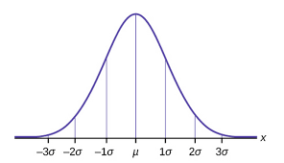
Using the Scores in Decisions
Low Score
APPLICATION SCORE
High Score
Very High Risk
Worst Applicants. Reject these applicants
High Risk
Reject these applicants or give low limits and apply higher pricing.
Standard Risk
Good applicants: Accept
Very Low Risk
The best applicants. Consider higher limits
www.apds-analytics.com

Slide 19
Analytics Across Business Areas
GDS Link Asia
Business Area | Challenge | Model | Data | Business Outcome
Prospecting | Who is the right customer to target? How can we cost effective market to the right customer? Can we pre-screen the risk associated with our targets? | Propensity to Respond Propensity to Take-Up | Alternative Data Demographics Account Management | Improve Customer Loyalty Reduce Marketing Costs Increased Marketing Efficiency Reduced Attrition Increased Revenue / Profits
Origination | Who to accept and reject? Under what terms and conditions? Can I X-sell addition products to the applicant? | Application Scores Bureau Scores Application Fraud | Demographics Bureau Data Alternative Data Account Management | Risk Profiles Improved Customer Service Reduced Losses
Customer Management | Which of my existing customers can we x-sell or up-sell additional products and services to? Which customers can we offer an increase in limit? How do we determine pre-delinquency treatments? | Behavioural Scores | Demographics Bureau Data Alternative Data Account Management | Risk Profiles Improved Customer Service Increased Market Share Increased Profits Reduced Losses
Usage | How can we identify the customers most likely to use the product more? How do we identify the profitable customers that are likely to close their facilities? | Revenue Models Utilisation Attrition | Demographics Bureau Data Alternative Data Account Management | Increased Revenue / Profits
Collections | Which delinquent customers to we collect upon? How do we prioritise collection treatments? Which accounts do we collect, litigate, sell or write-off? | Collections Scores Payment Projection Loss Forecasts | Demographics Bureau Data Alternative Data Account Management Collections Management | Reduced Losses Increased Recoveries
Regulatory Models | How much capital do we need? Can we estimate our provisions based upon the lifetime of the facility? How will the economy affect our capital and provisioning positions in the future? | PD, EAD and LGD models for AIRB PD, EAD and LGD Models for IFRS9 Macroeconomic models for stress testing and scenario analysis | Demographics Bureau Data Alternative Data Account Management Collections Management Macroeconomic Data | Capital Planning Expected Loss Calculation for Provisioning Long Term Business Planning
www.apds-analytics.com

Slide 20
Benefits of Credit Scoring
GDS Link Asia
Automated
Decisioning
High Level of Control
Reduced
Losses
Increased Revenue
Increased Portfolio Knowledge
Optimised
Portfolios
Increased Regulatory
Standing
Engaged Staff
Maximised Opportunity
www.apds-analytics.com
Notes:
Automated Decisioning
Scorecards and Policy Rules can be implemented within a computer system to increase the speed of credit decisioning and reduce the operational cost
High-level of Control
By removing subject elements of manual underwriting and parameterising the process
Stems from better understanding of the relationship between risk and business volume
Increased Revenue – through customer value optimisation and cross-sell
Reduced Losses – through risk management and targeted collections strategies

Slide 21
Questions
www.apds-analytics.com

Slide 22
Exercise 1 (1 hour)
List three areas where the concept of scoring could be applied to your bank / organisation
  What’s the business problem that could be addressed?
  What data would be used or could be useful?
  Discuss the business case for doing such a thing?
  Ideation sessions

Slide 23
Decision Areas

Slide 24
GDS Link Asia
Acquisition Analytics
Is the bank targeting the right customers?
Is the bank using Alternative Data to target thin file or unbanked customers?
Is the bank acquiring customers based upon the bank’s risk appetite and assigning appropriate terms and conditions based upon the risk profile?
Does the bank capture and store the right data for the use within scoring and strategy deployment?
Is the bank maximising the benefits of using date from both internal and external datasources (bureau data / alternative data)?
Is the bank satisfying the prevailing regulatory compliance criteria?
www.apds-analytics.com

Slide 25
Acquisition Analytics
GDS Link Asia
Key Analytic Area at a Acquisition Level
App
Scores
Bureau Scores
Alt Data Scores
Fraud Scores
Propensity Scores
www.apds-analytics.com

Slide 26
Analytics in the Acquisition Area
Application Scoring - Overview
Business Challenge: Automate the Acquisition decisioning process based on the Risk Profile
Solution: Application scorecard build to predict Delinquency Outcome
Application scorecard using Application Demo data
Can use Bureau data, and Internal other Product data
Usually use past Delinquency behaviour to predict
outcome i.e. 90+DPD Default definition
Benefits:
Reduction in Bad debts
Aim of high level of Automation
Tool for Risk Based Pricing
The recent past
Some time later
THEN
NOW
Development Sample
Statistical
Model
Outcome
Constant | +800
Age of Applicant
<22 | -50
22-25 | -10
26-40 | 0
41-55 | +30
Worst status Last 6 months
0 | 0
1-2 | -45
3+ | -100
Joint Applicant
Y | +20
N | 0
Low Score
APPLICATION SCORE
High Score
Very High Risk
High Risk
Standard Risk
Very Low Risk

Slide 27
Acquisition Analytics – Combining Scores
GDS Link Asia
Combining the internal application scores with the bureau scores enables the bank to consider a customer’s credit position at other financial institutions and also consider cases that may have been previously rejected if only internal data was considered
Application | Bureau
 |  | Low | Medium | High
 | Very Low | Reject | Reject | Refer
 | Low | Reject | Refer | Refer
 | Medium | Reject | Accept | Accept
 | High | Refer | Accept | Accept
 | Very High | Accept | Accept | Accept
Benefits
Increase in predictive power of acquisition decisioning
Reduction in Bad Debts
Expansion in the number of applicants that can be offered facilities (e.g. previous high risk internal only applicant can now be referred, instead of rejected)
Aim for high level of automation
www.apds-analytics.com

Slide 28
Acquisition Analytics – Characteristic Examples
GDS Link Asia
Application Scorecards utilise characteristics derived from historic applications, example characteristics include: -
Application Data
Age
Marital Status
Residential Status
Employment Status
Industry Type
Time at Current Job
Time at Current Address
Phone Indicator
Gender
No. of Dependents
Guarantor Flag
Debt to Income Ratio
Application Data by
Portfolio
Cards Requested Limit Card Type Auto Finance Loan Tenure Deposit Vehicle Status
Home
Property Type Loan to Value Ratio
Property Location Number of Applicants
Bureau Data
Worst Delinquency Number of Times Delinquent Number of Facilities
Time since most recent opening
Number of Enquiries Exposure Levels by product type / total
Legal Status Outstanding Balance
*** L1M / L3M / L6M / L12M
www.apds-analytics.com

Slide 29
Acquisition Analytics – Alternative Data Characteristic Examples
GDS Link Asia
Application Scorecards utilise characteristics from Alternate Datasources (Telco, Handset, Internet Data), example characteristics include: -
Telco Data
Handset Type
Length of time customer
Number of Calls last week
Pre-paid / Post-paid
Last Handset Renewal
Handset Data
Handset Usage Number of Apps
Time on Internet last week (minutes)
Average Screen Time
Time in Use
Location
Area of Residence (handset location 12am – 6am)
Number of times outside residential area 6am 12pm last week
Number of Locations between x and Y times
Website Category Searches
Psychometric Data
Average Time to response to question A, B, C (6 moral questions)
Time Taken to Answer DoB
www.apds-analytics.com

Slide 30
Acquisition Analytics – Propensity Models
GDS Link Asia
Propensity Models help to determine which customers are likely to use the product on offering, enabling the bank to select the most profit customers
Models can cover many areas : -
    Product Propensity – which product, when Credit Propensity – determining which customers need additional credit
    Usage – determining which customers will generate the most revenue through greater usage
Benefits include
    Strategic Customer Targeting
    Reduced Marketing Costs
    Efficient Decisioning Increased Revenue
Examples
    Propensity to spend on a Credit Card
    Propensity to Revolve a balance on a CC
    Propensity to Attrite / Switch a Mortgage
www.apds-analytics.com

Slide 31
Acquisition Analytics – Propensity Data Examples
GDS Link Asia
Propensity Models utilise characteristics derived from historic applications, existing accounts & alternative data , example characteristics include: -
Product Propensity Data
Demographics Age
Marital Status
Education
Behavioural
No. Accounts by product type
Credit Turnover
Time since loan paid up
Bureau
No. Credit Accounts
No. Enquiries
Alternative Data
Time at Telco
Credit Propensity
Demographics
Age
Phone Indicator
Education
Behavioural
No. Accounts by product type
Debit Turnover
Card Utilisation
Time since loan paid up
Number of Transactions L1M / L3M / L6M
Bureau
No. New Credit Accounts last 3 months
No. Enquiries last 6 months
Alternative Data
Mobile Screen Time last month
Usage Propensity
Demographics
Age
Marital Status
Education
Behavioural No. Accounts by product type
Credit Turnover
Time since limit increase (months)
Bureau
No. Credit Accounts last 6 months
No. Enquiries last 6 months / last 3 months
Alternative Data
Number of web searches by category last 7 days
Number of Travel Searches

Slide 32
Acquisition Analytics – Fraud
GDS Link Asia
Increasing levels of identity fraud leads to increasing fraud losses at a diverse range of banks
Data and Models can be used to help the bank identify cases that would require further investigation (searching for anomalies in the data)
    Application Fraud Models
    Use of bureau data is permitted
    Potentially early bads may be classed as fraudulent
Benefits (taken from a UK example)
    Referral of 9% of Applications for further investigation
    Detection of 56% of fraud cases, saving the bank money Example Characteristics include complex interactions, e.g. Age and High Income

Slide 33
Analytics and Customer Management
GDS Link Asia
Maximising the use of the bank’s data that can be mined from existing customers
Is the bank pro-actively managing it’s existing customer base to drive revenue and reduce costs?
Behavioural Scoring in Customer Management
Is the bank managing relationships at an account level?
Is the bank managing relationships at a customer level?
Pro-actively managing the customer base?
Identifying high value customers for potential upsell / x-sell?
    Increase Revenue from X-Sell Opportunities and grow the portfolios X-Sell
    Identify customers that are starting to look vulnerable? (triage)
    Prioritising the flow into collections and determining appropriate actions
    Increased (Early) Collection Process Efficiency & Reducing Roll-Rates
www.apds-analytics.com

Slide 34
Customer Management Analytics
GDS Link Asia
Key Analytic Area at a Customer Management Level
Account Level Behavioural Scorecard
Customer Level Behavioural Scorecard
Collection & Recovery Scores
Revenue & Propensity Scores
www.apds-analytics.com

Slide 35
Customer Management Analytics
GDS Link Asia
Key Analytic Area at a Customer Management Level
Account Level
Behavioural Score
Customer Level
Cross Sell Scores
Early Collections Scores
Customer Level
Behavioural Score
Revenue Scores
(propensity to use)
Late Collections & Recovery Scores
www.apds-analytics.com

Slide 36
Looking at Behavioural Scoring and how to use
Strategy
Exposure Management
Cross-Sell
Portfolio Data
Behavioural Scoring Chars
(Examples)
Max Delq last 6 months
Numbers times 30+ last 12 months
Number of Overlimit last 3 months
Number of Payments greater than minimum payment last 6 months
Max Utilisation last 9 months
Number of Collection Calls last 24 months
Modelling
Clean
Triage
Exposure Management
Dirty
Segmentation
Delinquent
Collections Priorisation
Roll-Rate Management
Default / Late Collections
Payment Projection
Recoveries Management

Slide 37
Customer Management Analytics – Collections Management
GDS Link Asia
Account Status
Up To Date
1-29 Days Past Due
30 - 90 Days Past Due
90+ Days Past Due
Behavioural Scoring
Roll-Rate Model
Payment Projection
Description
Manage Customers Relationships through
Pro-active limit management
Competitive Pricing
Pre-emptive Triage
X-Sell Programmes
To maximise profitability by balancing expected revenue with associated levels of risk and exposure
Initiate Customer Contact for
Debt Control
Triage
Limit Management
To maximise profitability by balancing expected revenue with associated levels of risk and exposure, whilst catching early delinquency
Continued Customer Contact for
Prioritised Debt Control
Arrears Management
Save the Relationship?
To minimise roll-rates to non-performing bucket whilst determining whether to save the relationship or minimise loss
Decision made to end the customer relationship, therefore switch to
Recovery Strategies
Debt Sale
Litigation
To maximise recovery cash-flows and minimise losses to the bank
Objective

Slide 38
Customer Analytics
Behavioural & Collections Scoring is used to predict which accounts or customers will go into the late stages of delinquency (often 3 cycles plus, although more complex performance definition can be used on a product by product basis)
Often the score is grouped in to risk grades and appropriate actions taken by grade
What is it?
High
Risk
High Risk Collections
Intensive Contact Strategy / Early Debt Sale
Identify Future Delinquents, reducing losses
Identifying cases that will self-cure will allow resources to be concentrated where they are needed
Identifying x-sell potential will increase revenue
Day 1
Why
Medium
Risk
Standard Collections Process
Tailored Use of Resources
Day 7
A behavioural score is often an integral part of the bank’s customer management infrastructure and can be used to determine x-sell opportunities (from a revenue perspective)
The score is also key to identifying customers that are deteriorating so that preventative measures can be taken to pre-cure before delinquency
The score would also be used in the early stages of delinquency to prioritise strategies
How?
Low
Risk
Soft Touch Collections Process
New Facility offers
Day 21

Slide 39
Customer Management Analytics - Sampling
GDS Link Asia
Independent Variables
Performance Variables
Data Elements can be at account or customer level OR be external bureau type chars
Transactional Data
e.g. Delq L3M
Bureau Data, e.g. No. of accounts
Internal Data, e.g. Other Account Delq
Contact History, e.g. £ of PTPs taken
Performance File
Good-Bad Flag
One Record per
Account / Customer
Observation Period
(usually up to 12 months)
Outcome Period
(dependent upon model purpose)
Know Info @ Decision Point
Outcome
Outcome is shorter for Colls Models
Observation
Point

Slide 40
Customer Management Analytics
Characteristic Examples
GDS Link Asia
Customer Management or Behavioural Scorecards utilise characteristics derived from historic account or customer performance, examples characteristics include: -
Account Level Data
Account Info
Account Age
Time with Bank
Transactional Variables
Credit Turnover (o/d accounts)
Min / Max Balance Change in Balance
Average balance last 3 months
Time since last Delinquent
No. Times Delinquent last 12 months
Average Utilisation Last 6 months (cards / O/d)
Customer Level Data
Internal
Worst Risk Grade across all accounts
Worst Delinquent Status by Product last 6 months
Time since max delinquency
Total Customer Exposure
Total Savings Balance No. Products
External
Open Banking, Number of CC Products
Open Banking, Total Exposure last Month
Collection & Recoveries Model Data
No. Promises to Pay Made in the last 3 months
No. of Broken PTPs made in the last 6 months
No. of right party contacts made in the last 12 months
Time since last collections call
Time since last payment
Contactability Flag
Amt Collected last 3 months
Number of Payment last 12 months
Probability of Possession Given Default
www.apds-analytics.com

Slide 41
Questions

Slide 42
Exercise 2
Earlier we listed out areas where your bank may apply scoring concepts, now please list or revisit the data you would need to build upon the identified uses

Slide 43
Discussion Area – Exercise 2
Let’s Talk Data for ABC Bank Scoring Concepts

Slide 44
Modelling Steps

Slide 45
Scorecard Development Steps
Low predictive chars will be business logic check to determine whether they are considered for modelling
Modelling
Characteristic Classing
Modelling – Linear vs Logistic Regression
Model Assessment & Re-model
Finalisation Workshop & Report
Design and Data Requirements
Initial Analysis
Variable Reduction
(PCA, Correlation, VoI)
Modelling incl Reject Inference
Design
Design Workshop
Business Objective / Problem
Data Availability
Portfolio Nuances
Design Document
Initial Analysis
Data Read In
Data Manipulation
Performance Definitions
Segmentation
Sampling
Initial Analysis Workshop & Report
Model Diagnostics
Strategy Develop
Essential that the design is correct and aligned to business requirements
Design is confirmed through data analysis
e.g. the performance definition, the development sample etc
www.apds-analytics.com

Slide 46
Data Sample Construction
GDS Link Asia
Design
(Business Problem, What Data is Available, High-level Solutionising)
Application Scoring
Sample Window
Outcome Window
12 Months Applications
12 Months Performance
Data Sourcing
(extract, merge, quality checks etc.)
24 Mths
Ago
(Jan 2013)
12 Mths
Ago
(Dec 2013)
Outcome Point
Now
(Dec 2014)
Behavioural Scoring
Observation Period
Outcome Window
Data Manipulation
(char derivation, segmentation investigation, performance definitions, exclusions etc.)
12 Months Applications
12 Months
Performance
Obs Point
24 Mths
Ago
(Jan 2013)
12 Mths
Ago
(Dec 2013)
Outcome Point
Now
(Dec 2014)
*could have multiple sample windows

Slide 47
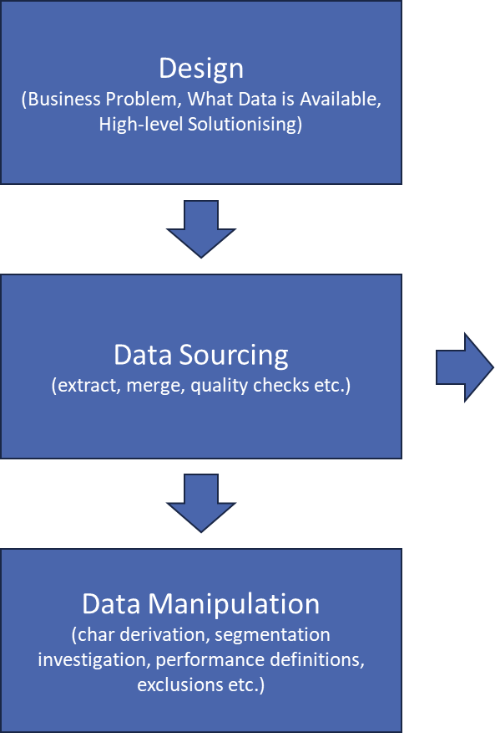
Data Sample Construction
GDS Link Asia
Modelling Data
Sample Window
Jan
1
Outcome Point
Feb
2
Monthly Application
Or Transactional
Files
Mar
3
Rolling Observation Windows
Rolling Performance Windows /
Dec
12
*Typically used when the number of bads is not low, and mature relatively quickly or when the portfolio requires a fixed outcome period (i.e. all bads have the same time to exhibit poor performance)

Slide 48
Development Team Data Sample Construction
Fixed Window
GDS Link Asia
Modelling Data
Outcome Point
Sample Window
Transaction Data
Performance Data
24
Months Ago
12
Months Ago
Now
*Typically used when the number of bads is low, the earliest bads are given longer
(up to 24 months in this case) to mature

Slide 49
Example Performance Definition - Complex
Design
(Business Problem, What Data is Available, High-level Solutionising)
GB Flag | Good-Bad Definition | Classification
1 | Voluntary Cancel / Close / Deceased / Never Active | Exclusion
2 | Bankruptcy | Bad / Default
3 | Write-Off | Bad / Default
4 | Re-Age / Re-Structured | Bad / Default
5 | Ever 90+ Days Past Due >= $100 in the last 12 months | Bad / Default
6 | Ever 60+ Days Past Due in the last 12 months | Indeterminate / Non-Default
7 | Ever 30+ Days Past Due in the last 12 months | Indeterminate / Non-Default
8 | Ever x-Days Past Due in the last 12 months | Good / Non-Default
9 | Up-to Date in the last 12 months | Good / Non-Default
Data Sourcing
(extract, merge, quality checks etc.)
Data Manipulation
(char derivation, segmentation investigation, performance definitions, exclusions etc.)
www.apds-analytics.com

Slide 50
Example Performance Definition - Simple
Design
(Business Problem, What Data is Available, High-level Solutionising)
The aim is to the scorecard development as simple as possible
GB Flag | Good-Bad Definition | Classification
1 | Ever 90+ Days Past | Bad / Default
2 | Ever 30 – 90 Days Past Due in the last 12 months | Indeterminate / Non-Default
3 | Ever 30+ Days Past Due in the last 12 months | Indeterminate / Non-Default
4 | Worst Status x-Days Past Due in the last 12 months (includes current) | Good / Non-Default
Data Sourcing
(extract, merge, quality checks etc.)
Data Manipulation
(char derivation, segmentation investigation, performance definitions, exclusions etc.)
www.apds-analytics.com

Slide 51
Defining Exclusions (Application)
GDS Link Asia
Customers have certain characteristics which the bank views as favourable, therefore the applicant will be accepted regardless of score, e.g.
    a Premium Banking Customer
    a Brand Ambassador
    a VIP
The bank would like to treat these customers differently from the normal thru the door population when they for credit
Example Exclusion Rules VIP
    Staff
    Students
    Pre-Approved Customers
www.apds-analytics.com

Slide 52
Defining Policy Rules (Application)
GDS Link Asia
The applicant will automatically be rejected when hit any of the bank’s Policy Rules (which define the bank’s lending or regulatory criteria)
Policy Decline Rules are a set of criteria which each applicant must pass regardless of their application score
Example Policy Rules
  Age Between 18 and 70
  Derogatory Records (Bankrupt, Legal Action, Charged Off)
  Excessive Credit Exposure
  High Debt to Income Ratios
Where the bank allows policy exemptions, we may analyse the effectiveness of the policy rules by looking into default rates by exception rule
www.apds-analytics.com

Slide 53
Defining Exclusion Rules (Behavioural)
GDS Link Asia
For the behavioural model the customer is already on book therefore the exclusion rules are slightly different
There two levels of exclusion rules for existing customer, Observation & Outcome
Example Observation Exclusion Rules
    Bad at Observation
    Inactive in the 12 months prior to Observation Point (no predictive data)
    Fraud / Lost or Stolen / Dispute
Example Outcome Exclusion Rules
    Deceased in the performance window
    Inactive for the entire performance window
    Fraud / Lost or Stolen / Dispute
Basel and IFRS9 Models may have separate exclusion rules, therefore these must be known as the operational scorecards are often the keystone within those model structures
www.apds-analytics.com

Slide 54
Exercise 3 – Performance Definitions and Outcomes
Please define your performance definition for your risk or propensity model
  What are your key assumptions and the rationale behind your thinking?
  Please relate your definition back to a business prompt?

Slide 55
Exercise 3 – Discussion
Please define your performance definition for your risk or propensity model
Discussion

Slide 56
Day 1 - Reflections
Any Questions?
Anything you’d like to go over again?

Slide 57
Defining Data
GDS Link Asia
Spec the data (Dev Team, Business Reps)
Extract Data (IT Team)
Initial Data Analysis to assess data (Dev Team) quality
  Depth
  History
  Comparisons between segments, e.g. Accepts & Rejects
  Population Rates
  Expected Values
Future Data Availability (Dev Team, IT Team)
Data Audit Report (Dev Team, Business Reps, IT)
Data Sourcing
(extract, merge, quality checks etc.)
Data Extract
(application data, associated performance, sufficient time periods)
Data Manipulation
(char derivation, segmentation investigation, performance definitions, exclusions etc.)
Who?
Dev Team
Business Reps
IT
www.apds-analytics.com

Slide 58
Data Prep
GDS Link Asia
For data assessment and specification two main areas are investigated. The first step is to look at the ‘Quantity’ of data available and whether the information is sufficient (and covers all the necessary fields) to construct appropriate scorecards. The second step is to determine whether the available data is of adequate ‘Quality’ and is a more analytic exercise.
Ref No. | Data Item | Portflio | Best Practice Recommendation | Bank Available
1 | Balance | CC | Y | Y
2 | DPD | CC | Y | Y
3 | Open Date | CC | Y | N
4 | Limit | CC | Y | Y
5 | Payment | CC | Y | Y
Step 1 – Quantity
Data Quantity assessment of the key data fields for in scope portfolios
Starting point is always best practice variable lists
Recommendations of required fields
Recommendations of going forward fields
Step 2 – Quality
Review of data elements within each field by assessing population rates, data accuracy through detailed analysis of documentation, data items etc
Data Quality Assessment should include descriptive statistics, accuracy tests, documentation review and recommendations
www.apds-analytics.com

Slide 59
Data Check & Audit
GDS Link Asia
To determine scorecard development feasibility the following analysis will be undertaken, to determine
    Depth of Data
    Breadth of Data
For Numerical Characteristics, frequencies will be produced investigating the descriptive statistics of mean, min, max to highlight any data anomalies
For Categorical Characteristics the frequency tables will investigate that the appropriate codes are populated correctly
For Example
    Balances are within the expected ranges, i.e. all positive and no abnormally high values
    Charge-Off is expected to values of A to E but a value of X is observed
    No. of Written Off accounts is expected to be 2% but 20% of cases have that status#
Additionally
    Data Availability to code exclusion rules, good-bad definitions (including the default definition) exist and are well populated
    The supplied data is logical and no irregular trends are observed, examples include
      movement through delinquency buckets follows expected trends, i.e. Jan 2013 DPD is 0, but 90 dpd in February
      Valid Open Dates exist
      DPD registers a zero value but the account is charged off
      Number of records the expected number of records
www.apds-analytics.com

Slide 60
Data Manipulation
GDS Link Asia
Valid Match Keys
Sorted Match Keys on both files (application and performance)
Explain any duplication (or remove)
Check the range of the match keys
Sense check match rates
Verify that the merged file contains the relevant and correct data
Investigate any unmatched records
Matching Data
(outcome &
performance)
www.apds-analytics.com

Slide 61
Data Needed for Application Scorecards
GDS Link Asia
Observation
Point
Outcome
Point
Outcome Period
Typically 12 to 24 months
Monthly account performance information for each month in the outcome, used to determine the GB Flag
Data as at point of Application
For Credit
Appl
Data
Existing
Accounts
Credit
Bureau
Other
Sources
Perf
Data
Historical Application
Data, for covering 12
Months of applications
Account / Customer
Data from existing
client
Customer Credit
Data from other
Financial Institutions
Open Banking, alternative datasources
Monthly Account
Performance Data
www.apds-analytics.com

Slide 62
Data Needed for Behavioural Scorecards
GDS Link Asia
Observation
Point
Outcome
Point
Outcome Period
Monthly account performance information for each month in the outcome, used to determine the GB Flag
Typically 6 to 12 months
Data as at point of scoring
Historic
Account
Data
Current
Month
Data
Credit
Bureau
Other
Sources
Perf
Data
Historical Account or Customer
Data, for covering 12
Months of performance
Account / Customer
Data from existing
Client in the month of
observation
Customer Credit
Data from other
Financial Institutions
Open Banking, alternative datasources
Monthly Account
Performance Data
www.apds-analytics.com

Slide 63
Data Preparation & Initial Analysis
GDS Link Asia
Data Derivation
Raw Data
e.g. Max Delq Last 3m
Min Balance last 6m
etc
‘Turning the (raw) data into information’
Performance Definition
Bad – ever 90 dpd inside X months
Sampling

Slide 64
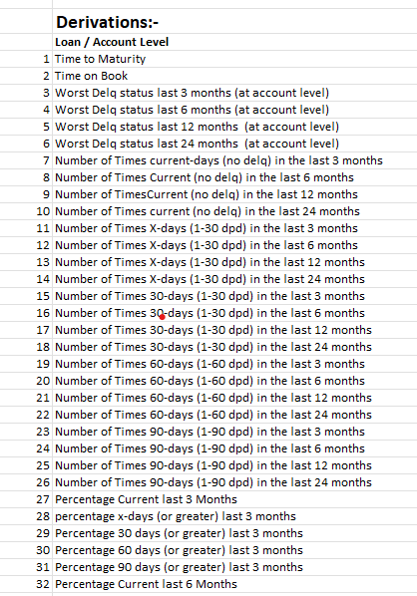
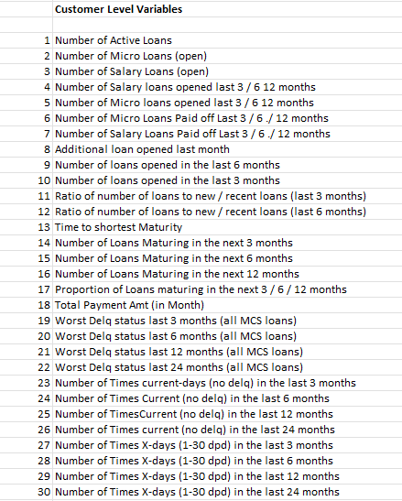
Example of Raw to Derived
Raw Data
Derived Data
Column ID | Column Description | Comment
CIF_ID | Customer ID
FORACID | Loan Account ID
OPEN_DATE | Loan Open Date
MATURE_DATE | Loan Mature Date
DISBURSED_AMOUNT | Loan Disbursed Amount
SCHM_CODE | Loan Product Code
DR_INTEREST_RATE | Interest rate
BALANCE | Balance as of reporting date
OVERDUE_PRINCIPAL | Overdue in principal
OVERDUE_PDAY | Overdue days in principal
OVERDUE_INTEREST | Overdue in interest
OVERDUE_IDAY | Overdue days in interest
TOTAL_AMT | total overdue amount | overdue principal + interest
REPORTDATE | report date
www.apds-analytics.com

Slide 65
Data Exercise
GDS Link Asia
  Raw Data
  ‘ min_repordate',
  'max_reportdate’,
  'CYCLE_COUNT',
  'CYCLE_NUM',
  'CYCLE_POINT',
  'loan_product’,
  'CIF_ID',
  'FORACID’,
  'OPEN_DATE',
  'MATURE_DATE',
  'DISBURSED_AMOUNT’,
  'BALANCE’,
  'OVERDUE_DAY',
  'TOTAL_AMT',
  'REPORTDATE’,
  ‘Delq Cycle’
  ]
Derived Data
Please design 5 derived characteristics
based upon the raw data
www.apds-analytics.com

Slide 66
Sample Window Selection
GDS Link Asia
  Considerations for the Sample Window chosen
  Volumes
    Is there enough volume within the good-bad categories? Typically, scorecards require at least 750 of each
    Do sufficient volumes exist for the suggested or desired scorecard segments?
  Is the Sample Window representative of the ‘Going Forward’ World?
    Long Outcome Windows may be less relevant
    Have there been or expected to be changes in the portfolio?
    Are the products offered today the same as in the past? How do they differ?
    Have there been any specific marketing events that need considering?
  Data Availability
    Are all the characteristics available for the entire observation period?
    Is retrospective bureau data available for the observation period?
  Seasonality
    Do special events in the year affect the flow of the portfolio, e.g. Christmas?
    Selecting 12 month observation window help to smooth out spikes in demand or delinquency?
www.apds-analytics.com

Slide 67
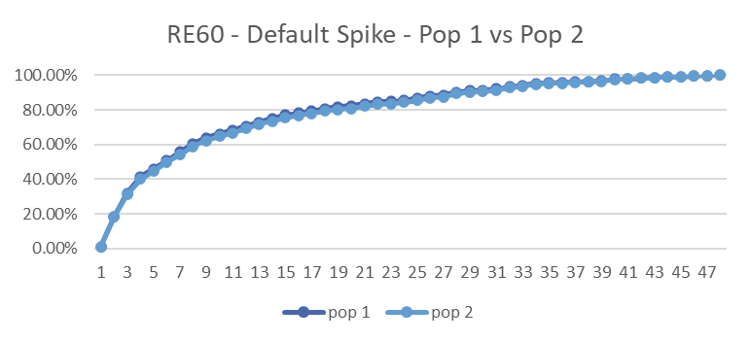
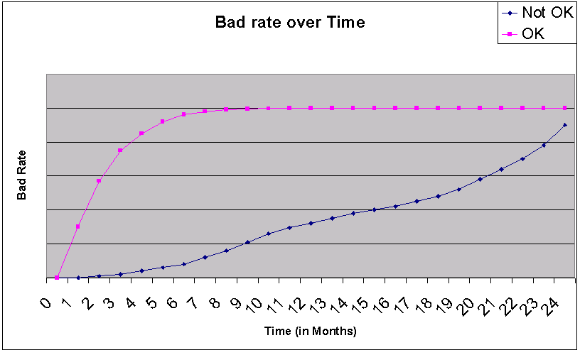
Vintage Analysis – Length of the window
GDS Link Asia
Time to Bad Analysis:
Vintage Report:
Choose period when bad rate is stable / flattens
Examination of the Bad Rate over time will identify the exposure required for the outcome period
www.apds-analytics.com

Slide 68
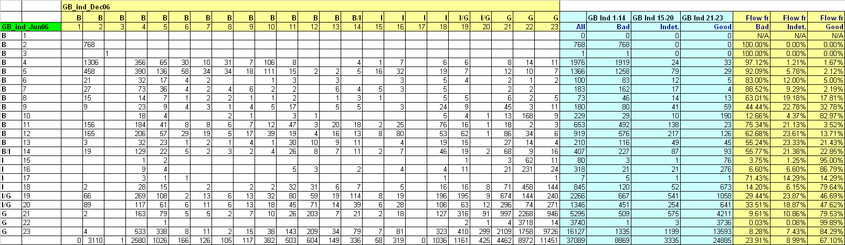
Roll-Rate Analysis – Confirming Good-Bad Def
GDS Link Asia
Example Roll-Rate Analysis:
www.apds-analytics.com

Slide 69
Why Segment?
App Pop
Origination
Diverse Customer Profiles
Improved Accuracy
  Segmentation enhances the accuracy of risk assessment by accounting for nuances within each customer segment, reducing the likelihood of misclassification.
Key Reasons for Segmentation
  Risk Differentiation – there are differences within the risk profiles associated with differing segments
  Customized Strategies – segmentation gives the ability to tailor risk management strategies to each segment, optimizing resource allocation and improving overall risk outcomes
  Adaptive Modelling - segmentation allows for adaptive modeling, ensuring that risk assessments remain relevant and effective in dynamic retail environments
  Implementation Challenges – segmentation allows for differing data by segment to be assessed
Increased Model Complexity – segmentation may add model risk into the process
salary
Non-salary
Bad Rate 1.2%
Bad Rate 4.2%
Existing
Customers
(behavioural
modelling)
Existing Book
Clean last 12 mths
Dirty
Curr
< 60 dpd
Pay Pred
www.apds-analytics.com

Slide 70
Confirming Segmentation – Differing Performance
GDS Link Asia
Current |  |  |  |  |  |  | Delq
Interval | Known Woe | Known GB Odds | Totals | Totals % |  |  | Interval | Known Woe | Known GB Odds | Totals | Totals %
0 | 3.66 | 40.72 | 453279 | 58.50% |  |  | 0 | 2.1 | 9.52 | 34500 | 32.20%
1-10 | 3.24 | 125.86 | 77675 | 10.03% |  |  | 1-10 | 1.75 | 17.47 | 19876 | 18.55%
11-25 | 2 | 39.84 | 65666 | 8.48% |  |  | 11-25 | 1.55 | 8.96 | 18249 | 17.03%
26-40 | 1.32 | 13.37 | 63213 | 8.16% |  |  | 26-40 | 1.5 | 5.06 | 15986 | 14.92%
41-50 | 0.34 | 8.18 | 54362 | 7.02% |  |  | 41-50 | 0.1 | 3.26 | 4500 | 4.20%
51-65 | -1.3 | 5.77 | 23421 | 3.02% |  |  | 51-65 | -0.6 | 2.33 | 4032 | 3.76%
66-80 | -1.8 | 4.5 | 16542 | 2.13% |  |  | 66-80 | -2.3 | 1.58 | 3333 | 3.11%
81-100 | -2.1 | 2.77 | 12652 | 1.63% |  |  | 81-100 | -3.2 | 0.9 | 3121 | 2.91%
101+ | -2.5 | 2.25 | 5643 | 0.73% |  |  | 101+ | -4.65 | 0.49 | 2321 | 2.17%
Others | 0.12 | 10.1 | 2352 | 0.30% |  |  | Others | -1.2 | 6.66 | 1234 | 1.15%
total |  | 17.17 | 774805 | 100.00% |  |  |  |  | 2.46 | 107152 | 100.00%
1. Is the Population large enough?
2. Are the GB Odds different?
3. Is the Risk Profile different?
4. Is the Population % distribution different?
Also compare Segment Characteristic Analysis Reports to the total population Characteristic Analysis to assess total differences
www.apds-analytics.com

Slide 71
Model Development
GDS Link Asia
Model Prep
Model Construct
Model Check
Univariate Analysis
Variable Reduction
Population Stability
Correlation Analysis
Business Rationale
Characteristic Analysis
Modelling
Dummy vs Weight of Evidence Models
Linear Regression
Logistic Regression
Decision Trees
Random Forests
Diagnostics
(Score Dist, Gini, KSI etc)
www.apds-analytics.com

Slide 72
Modelling Process Flow – Application Scores
GDS Link Asia
Modelling Samples
Build Known
Good-Bad Model
Build Accept-Reject
Model
Application Scores only
Reject
Inference
Only one model for B-Score & C-Score
Build Final Model
www.apds-analytics.com

Slide 73
Customer Management Analytics - Sampling
GDS Link Asia
Independent Variables
Performance Variables
Data Elements can be at account or customer level OR be external bureau type chars
Transactional Data
e.g. Delq L3M
Bureau Data, e.g. No. of accounts
Internal Data, e.g. Other Account Delq
Contact History, e.g. £ of PTPs taken
Performance File
Good-Bad Flag
One Record per
Account / Customer
Observation Period
(usually up to 12 months)
Outcome Period
(dependent upon model purpose)
Know Info @ Decision Point
Outcome
Outcome is shorter for Colls Models
Observation
Point

Slide 74
Introduction to Paragon Modeller
(www.credit-scoring.co.uk)
Reading Modelling Data – Read the given dataset
Basic Manipulation
Assigning Good Bad definitions / Generating Characteristics
www.apds-analytics.com

Slide 75
Exercise Discussion
What have we learnt?
Modeller Questions
www.apds-analytics.com

Slide 76
Modelling Steps 2

Slide 77
Model Process – Univariate Analysis
GDS Link Asia
PAST
DATA
Modelling
Score
Decide
Characteristic Reduction
PSI
Characteristic Analysis
Fine to Coarse Classing
Correlation Analysis
Business Rationale
Statistical Modelling
Linear Regression
Logistic Regression
Decision Tress
Random Forests
www.apds-analytics.com

Slide 78
Characteristic Reduction
GDS Link Asia
Importance of Reducing Variables within the Model Selection Process:
Simplicity and Interpretability (for model / product stakeholders, model validators / approvers & regulators)
More efficient to build, less opportunity for the developers to engineer in Model Risk
Reduced likelihood of generalised model over-fitting (tailored specifically to the development data)
Easier to implement and maintain
Simpler (lower characteristic models) tend to bed more robust and less prone to small changes in the operational environment, therefore are more reliable for longer
Simpler models have less monitoring and on-going modelling overhead
www.apds-analytics.com

Slide 79
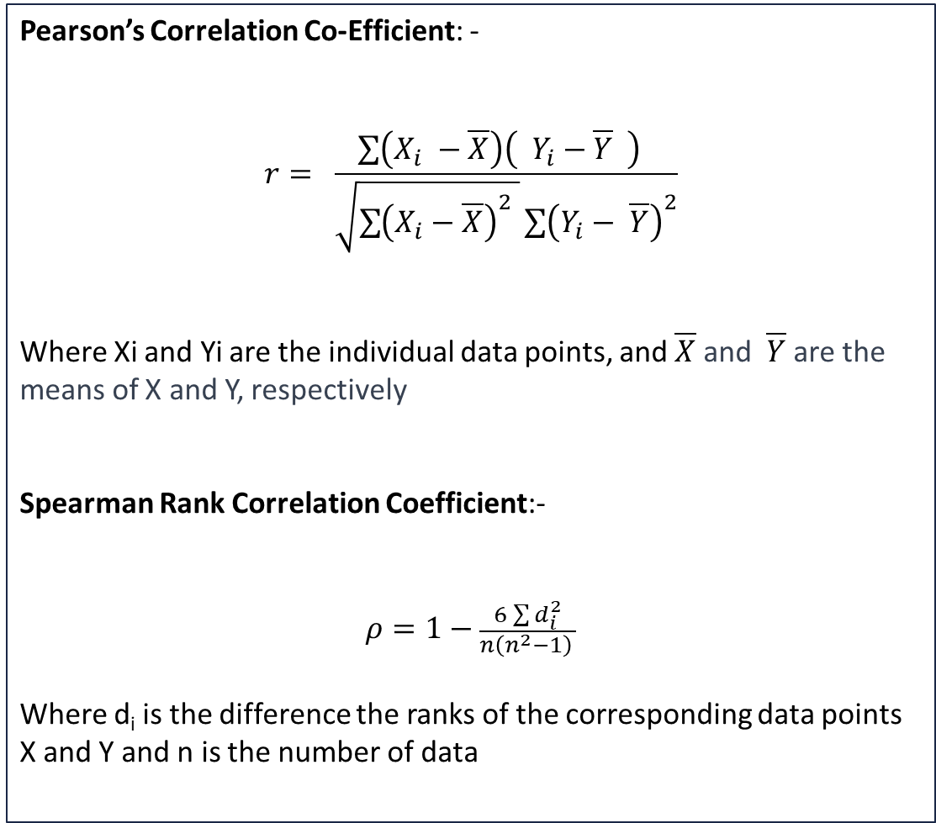
Correlation Considerations
Pearson’s Correlation Co-Efficient: -
$$r= \frac{\sum{\left(X_{i} −\overline{X}\right)\left( Y_{i}−\overline{Y} \right) }}{\sqrt{\sum{{\left(X_{i}−\overline{X}\right)}^{2} }}\sum{{\left(Y_{i}− \overline{Y}\right)}^{2}}}$$
Where Xi and Yi are the individual data points, and $\overline{X}$ and $\overline{Y}$ are the means of X and Y, respectively
Spearman Rank Correlation Coefficient:-
$$ρ=1−\frac{6\sum{d_{i}^{2}}}{n\left(n^{2}−1\right) }$$
Where d_{i} is the difference the ranks of the corresponding data points X and Y and n is the number of data
Correlation is a measure of how similar or how the information given by the characteristic is the same as the other variable
Highly correlated variables may interact with each other and cause the models to be over fitted
Where multicollinearity exists the true relationship between variables may be hidden
Where correlation exists the opinions of model or portfolio experts may be blunted
Within the scorecard arena we typically utilise Pearson or Spearman Correlations metrics
www.apds-analytics.com

Slide 80
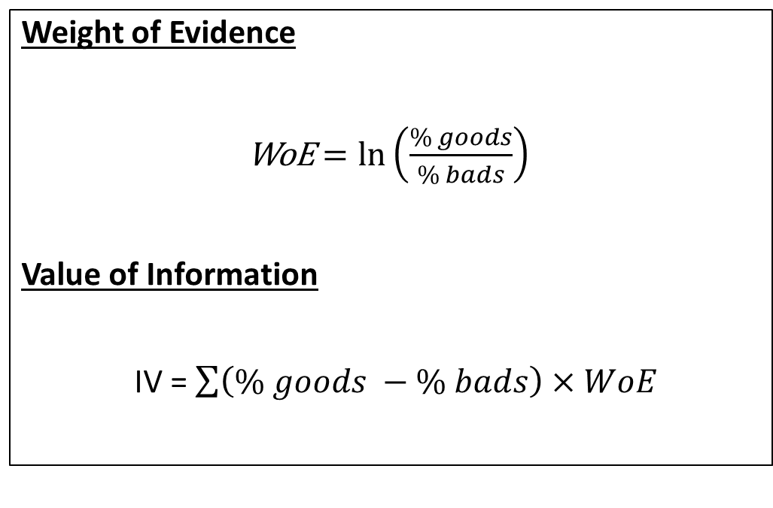
Selection Statistics
Weight of Evidence / Value of Information
Weight of Evidence is a relationship between the proportion of goods and bads with a particular attribute of a cell
The Value of Information or Information Value is a measure of predictive power across the variable
Weight of Evidence
WoE $=\ln\left(\frac{\% goods}{\% bads}\right)$
Value of Information
IV = $\sum{\left(\% goods −\% bads\right)}$ $×WoE$
Range | Pred. Power | Action
<= 0.02 | Very Weak | Exclude / Drop
0.02 – <= 0.1 | Weak | Exclude / Drop / Review
0.1 - <= 0.3 | Medium | Include / Keep / Review
0.3 - <= 0.5 | Strong | Include / Keep
>= 0.5 | Very Strong | Include / Keep / Review
www.apds-analytics.com

Slide 81
Exercise – Modeller Field Reduction
Let’s play with the Field Reducer in Modeller
Discuss key fields / reduction parameters
Review the results
  What’s in the keep list?
  Anything worthwhile or business worthy in the delete list?

Slide 82
GDS Link Asia
Characteristic Analysis
  At a characteristic level the developer wishes to compare the distribution of goods and bads across the attributes in order to ensure that predictive trends are consistent and intuitive will perceive business logic
  The predictive trends across the attributes should be broadly linear in an increasing or decreasing manner (dependent upon the characteristic)
  Characteristics with counter-intuitive (unexpected) trends will be excluded from further analysis unless the trend can be explained due to business process and procedures, e.g. for product A, older customers are higher risk.
  Additionally, we try to keep greater than 50 goods and 50 bads in each characteristic group
  Records should not be overly concentrated in one attributed band
  We try to reduce the number of attribute groups to 6 or 7 (for low volume scorecards there are likely to be less groups, perhaps 4 or 5)
  Groups are combined into classes of similar risk (risk can be measured by GB Odds, Bad Rate or Weight of Evidence (WoE))
  Categorical fields should be grouped into like meaning categories, e.g. owned and mortgaged property
www.apds-analytics.com

Slide 83
Measures of Characteristic Performance
GDS Link Asia
  The developer wishes to ensure that the characteristics used within the model exhibit a degree of stability over time (ensuring that a robust model is constructed)
  The Population Stability Index (PSI) is the standard best practice measure used to determine stability across samples drawn from different time period
  The measure illustrates the discrepancy between two populations (development versus validation), when used with individual characteristics it will show that whether the information being given has changed
  PSI <= 0.1 means that the two populations are sufficient stable for the characteristic to be considered for model entry
 |  |  |  |  | PSI
Attribute | 2012 | 2012 Percentage (A) | 2014 | 2014 Percentage (B) | C= A -B | D=Ln(a/B) | E=C*D
Current | 229,195 | 0.56 | 233923 | 0.57 | -0.01 | -0.0117 | 0.0001
X-dpd | 107,295 | 0.26 | 117,042 | 0.29 | -0.02 | -0.0782 | 0.0017
30 dpd | 26567 | 0.07 | 16158 | 0.04 | 0.03 | 0.5060 | 0.0132
60 dpd | 17824 | 0.04 | 15284 | 0.04 | 0.01 | 0.1625 | 0.0011
90 dpd | 9967 | 0.02 | 7503 | 0.02 | 0.01 | 0.2927 | 0.0018
120+ dpd | 14847 | 0.04 | 19339 | 0.05 | -0.01 | -0.2556 | 0.0027
 | 405,695 | 1.00 | 409249 | 1.00 |  |  | 0.0205
www.apds-analytics.com

Slide 84
Measures of Characteristic Performance
GDS Link Asia
  The developer wishes to ensure that the characteristics used within the model are predictive, and utilises the Information Value (IV), also referred to as the Value of Information (VOI) as a measure of relative power
  Measures the discrepancy between goods and bads, taken from the same time based sample
  A Low value of VOI indicates that the good and bad populations are similar and is therefore not predictive, i.e. will not help to separate good and bad accounts or customers
 |  |  |  |  | VOI
Attribute | Good | Good Percentage (A) | Bad | Bad Percentage | C= A -B | D=Ln(a/B) | E=C*D
Current | 226,900 | 0.56 | 1,195 | 0.00 | 0.56 | 5.2551 | 2.9238
X-dpd | 105,800 | 0.26 | 897 | 0.00 | 0.26 | 4.7790 | 1.2358
30 dpd | 25,692 | 0.06 | 674 | 0.00 | 0.06 | 3.6494 | 0.2251
60 dpd | 16,889 | 0.04 | 886 | 0.00 | 0.04 | 2.9564 | 0.1167
90 dpd | 8,056 | 0.02 | 1,910 | 0.00 | 0.02 | 1.4480 | 0.0220
120+ dpd | 9,653 | 0.02 | 5,211 | 0.01 | 0.01 | 0.6252 | 0.0069
 | 392,990 | 0.97 | 10,773 | 0.03 |  |  | 4.5303
www.apds-analytics.com

Slide 85
Measures of Characteristic Performance
GDS Link Asia
  The developer wishes to ensure that the characteristics used within the model are not overly correlated, i.e. telling the same piece of information
  Correlation causes characteristics to come into the model with conflicting predictive trends that may be counter-intuitive and out of line with earlier project analysis (characteristic analysis trends)
  Characteristics with the highest VOI should be selected for regression consideration, assuming they have a correlation co-efficient greater than 0.3 (the threshold can be changed)
Characterictic | VOI
Worst Delq in the last month | 2.61
Worst Delq in the last 3 months | 2.73
Worst Delq in the last 6 months | 2.68
Worst Delq in the last 12 months | 2.71
www.apds-analytics.com

Slide 86
GDS Link Asia
Characteristic Analysis
Attribute | Good | Good % | Bad | Bad % | GB Odds | WoE | Total | Total %
Current | 226,900 | 0.56 | 1,195 | 0.0029 | 189.8745 | 5.255085 | 228,095 | 56.49%
X-dpd | 105,800 | 0.26 | 897 | 0.0022 | 117.9487 | 4.778972 | 106,697 | 26.43%
30 dpd | 25,692 | 0.06 | 674 | 0.0016 | 38.11869 | 3.649427 | 26,366 | 6.53%
60 dpd | 16,889 | 0.04 | 886 | 0.0022 | 19.06208 | 2.956423 | 17,775 | 4.40%
90 dpd | 8,056 | 0.02 | 1,910 | 0.0047 | 4.217801 | 1.448036 | 9,966 | 2.47%
120+ dpd | 9,653 | 0.02 | 5,211 | 0.0127 | 1.852428 | 0.625219 | 14,864 | 3.68%
 | 392,990 | 0.97 | 10,773 | 0.03 | 36.47916 |  | 403,763 | 100.00%
Predictive
Trend Observed
www.apds-analytics.com

Slide 87
Characteristic Analysis
GDS Link Asia
Attribute | Good | Good % | Bad | Bad % | GB Odds | WoE | Total | Total %
<= 0 | 106,811.00 | 27.19% | 3,655.00 | 34.03% | 29.22326 | 0.799194 | 110,466.00 | 27.37%
1-10k | 98,625.00 | 25.11% | 1,374.00 | 12.79% | 71.77948 | 1.963016 | 99,999.00 | 24.78%
10k-50k | 36,911.00 | 9.40% | 1,289.00 | 12.00% | 28.63538 | 0.783117 | 38,200.00 | 9.47%
50k-100k | 79,624.00 | 20.27% | 1,641.00 | 15.28% | 48.52163 | 1.326964 | 81,265.00 | 20.14%
100k-500k | 46,243.00 | 11.77% | 2,134.00 | 19.87% | 21.66963 | 0.592619 | 48,377.00 | 11.99%
500k + | 24,577.00 | 6.26% | 649.00 | 6.04% | 37.86903 | 1.035638 | 25,226.00 | 6.25%
 | 392,791.00 | 100.00% | 10,742.00 | 100.00% | 36.56591 |  | 403,533.00 | 100.00%
None-Predictive
Trend Observed

Slide 88
Characteristic Reduction for Modelling
GDS Link Asia
100
Characteristics
PSI <= 0.1
Stability
PSI > 0.1
20
80
20
No
10
70
Predictive
No
20
50
Correlation
20
Put into model after Fine & Coarse Classing
Characteristic Analysis
5
45
No Linear / Intuitive Trend
www.apds-analytics.com

Slide 89
GDS Link Asia
Characteristic Classing
  For numerical characteristics the first step of the process is to produce a set of fine classed characteristics (it is usual to break the characteristics into 20 fine classes, using a statistic ranking mechanism)
  The process converts the continuous nature of the variable into a categorical characteristic
  Group manually to reduce the number of attributes by ensuring that fine classes with similar GB Odds or Weights or Evidence are coarse classed together
  The Weight of Evidence of each Coarse class can be used within the regression analysis (alternatively Dummies can be modelled)
  Coarse Classes should be created on the following principles:-
    Increasing / decreasing trends (WoE or GB Odds)
    Less than 8 coarse classes (for low data models this may be reduced to 4)
    There should be greater than 2% of the population in each class
    No. of bads in each coarse class should be greater than 50 or 1% of all bads
    Unknown classes should be assigned to neutral classes, where WoE is close to zero
www.apds-analytics.com

Slide 90
Exercise – Grouping / Classing / Binning
Scorecard Building Starts now
Auto-grouping
Grouping

Slide 91
Model Development
Model Development
(Linear, Logistic Regression, other model types)
Model Diagnostics
(Gini, KS, Correlation)
Validation
(Hold-out, Bootstrapping, Out of Time)

Slide 92
Comparing Linear Vs Logistic Regression
Linear Regression
Logistic Regression
Advantages
Interpretability
Widely Applicable
Simplicity
Can be used with continuous outcomes
Disadvantages
Assumes linearity
Sensitive to Outliers
Limited in that it is not well suited to binary outcomes
Advantages
Requires Binary Outcomes
Produces probability based estimates
Less sensitive to outliers
Disadvantages
Complex Interpretation
Limited to linear division boundaries

Slide 93
Linear Regression Vs Logistic Regression (Equations)
GDS Link Asia
General form of Linear Regression
General form of Logistic Regression
Linear Regression
Where:
Y: dependent variable
α : general intercept
β: co-efficient applied to the explanatory variable
x: explanatory variable
The output of the regression model is a probability from 0 to 1
In Scoring:
Y: total score
α : constant
β: co-efficient applied to the characteristics
x: explanatory variable (e.g. age, income, sex)
350 [Y] = 200 [α ] + 50 x Age₃₀₋₄₀ + 40 x Income_{50k+} + 60 x Sex_{Female}
Other Form of Logistic Regression
www.apds-analytics.com

Slide 94
Comparing Linear Vs Logistic Regression Graphically
GDS Link Asia
Comparing Graphical Patterns: Logistic Regression Vs Linear Regression
LINEAR REGRESSION
LOGISTIC REGRESSION
x
x
GB
Odds
x
x
GB
Odds
x
x
x
x
x
x
x
x
x
x
x
x
x
x
x
x
Age
Age
Logistic Regression tends to fit to more of the datapoints, for example predicting score by age & GB Odds
www.apds-analytics.com

Slide 95
Dummy Models Versus Weight of Evidence
Dummy Models
WoE Models
Advantages :-
Characteristic Attributes split into dummy variable
Missing values easily handled
Encodes monotonically
Effective in binary classification
Disadvantages:-
Curse of dimensionally when there is are large number of attributes
Not used in continuous outcome models
Assumes a linear relationship between variables and target
Advantages:-
Characteristic Attributes assigned their respective weight of evidence
Applicable to all model types
Easy to interpret as each attributes becomes a variable
Variable contribution is easily observed
Disadvantages:-
Increased effort to prepare modelling sample (coding inefficiency)
Non-monotonic relationships may not be desirable
Tends to model the extremes
Does not handle missing variables well
www.apds-analytics.com

Slide 96
Tree Based Models

Slide 97
ML Models – Random Forests / XG Boost /NN

Slide 98

Score Creation and Scaling (PDO)
Score creation
To create the score for Dummy Models
  Multiple the Parameter Estimate by a user determined factor
  Sum across all characteristics, including the intercept
To create score for WoE Models
  Multiple the Parameter by the calculated attribute level WoE
  Sum across all model characterisrics, including the intercept
Points to Double the Odds
Points to Odds (pdo), often 20 or 50
Factor = pdo/ln(2)
Offset = Score – (Factor * ln(odds))
Scale the scorecards for comparison across the different models
Comparison is only meaningful if the same performance definition is used

Slide 99

Scorecard Diagnostics

Slide 100
Model Diagnostics - Kolmogorov–Smirnov (KS)
KS = 67.7
KS = 42.96
Maximum difference between cumulative % goods and cumulative % bads
Advantages: -
  Standard scale 0.0 - 1.0 comparable across models
  Identifies area where Scorecard works best (i.e. max separation)
Disadvantages: -
  Point of maximum difference may not fall at the decision point
www.apds-analytics.com

Slide 101
Model Diagnostics – Gini Co-Efficient / Lorenz Curve / RoC Curve
GINI CO-EFFICIENT 83.24
GINI CO-EFFICIENT 56.26
Measures the difference between the cumulative of goods and bads by score
Advantages: -
  Standard scale 0% - 100% comparable across models
Disadvantages: -
  Separation may be skewed to high or low scores only
www.apds-analytics.com

Slide 102
Reject Inference
By building a new model with reject inference we wish to maximise the number of ‘new goods’ from the old Reject population and minimise the number of ‘new bads’ from the previous Accepted population
Prev
Accepts
Prev Rejects
New
Goods
New
Bads
Drag the Rejects P(G) down as we assume rejects would perform worse than known population
www.apds-analytics.com

Slide 103
Reject Inference – Alternative Data (Bureau / Open Banking)
Bureau Data / Open Banking Data
  Search for similar loan types applied / approved shortly after reject at other lenders (does the bank have access to the data)
  Check performance of loans that were written, is this indicative of how the loan would have performed had we accepted it
  Compare the populations of rejects with the performance of known performance
Historic Loans (at bank)
Other Lending Products
www.apds-analytics.com

Slide 104
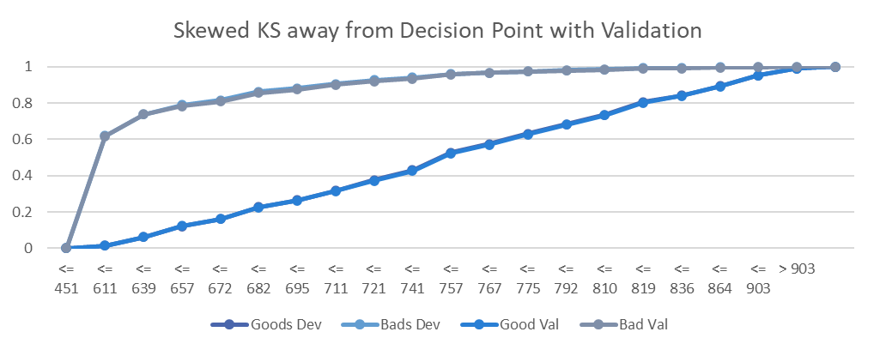
Model Validation
Model Validation should be carried out
  as part of the development process
  as an independent verification of model quality prior to model implementation or use
  periodically to confirm modelling assumption made at point of development hold and that the model continues to work as designed
Validation often uses
  a hold-out sample (develop model on 80% of sample, test on 20%)
  Boot-strapped validation (random samples pulled from the development sample to test the model)
  Out of time data sample
Hold-Out
Model Diagnostics / Validation
Boot-strap
Out of Time / Sample

Slide 105
Exercise – Modelling
Let’s build models
Model Assessment
Refinement

Slide 106

Other Modelling Issues

Slide 107
Other Models to Consider – IRB / IFRS9
IRB Models look to utilise multiple models to predict the capital requirements of the bank (by modelling the Probability of Default (PD), Exposure at Default (EAD) and Loss Given Default (LGD)
IRB Models should be adjusted for cyclicality across the economic cycle
Model weaknesses need to be address with Margin of Conservatism adjustment
IFRS9 models typically utilise similar modelling constructs but consider Lifetime PD, EAD and LGD
Revolving products may have complicated EAD models that aim to predict the amount of the limit that will be consumed by the time of default
LGD for mortgage products can also be complicated by the recovery processes within the bank and the legal structure / environment in which they operate
Monitoring and Validation of models is also important (covered in a separate session)
www.apds-analytics.com

Slide 108
Why is Model Risk Important?
What is Model Risk?
  Financial impact associated with utilising models to make key decisions within a bank or financial institution
  Reputational risk from making poor decisions
  Arises from model error and prediction inefficiency
  Propagated by lack of appropriate controls
Why is Model Risk important?
  Models are increasingly used in an ever-expanding range of operational and regulatory decisions
  If not understood and managed the risk can aggregate to a level that is outside the bank’s risk appetite
  As with all risks, if not managed a financial loss could occur
Where does Model Risk arise from?
  From each and every aspect of the model lifecycle
  We’ll focus on model development here
www.apds-analytics.com
Notes:
Add war stories on the individual slides

Slide 109
Regulatory Landscape
Model Risk Regulations or Guidelines have been published by a number of Regulators, including
  Federal Reserve (SR11-7 – Guidance on Model Risk - April 2011)
  Bank of England (SS1/23 – Model Risk Management Principles for Banks – May 2023 )
  CBUAE (Model Management Standards (MMS) & Guidelines (MMG) – December 2022)
  ECB (Guide to Internal Models – Oct 2019)
The Guidance can be
  Principles based – allows a great deal of freedom in terms of how the models are managed as long as management of the models follows a general path
  Prescriptive – sets in stone how models should be developed and managed
More developed markets with sophisticated banking groups tend to have gone down the principles-based approach, whereas developing markets are more prescriptive
Many global regulators are yet to release guidance, firms in those regions may want to get ahead of the curve
www.apds-analytics.com

Slide 110

Modelling and AI

Slide 112
Thank You
www.apds-analytics.com

Slide 113
Risk Modelling Training by
APDS Consulting
www.apds-analytics.com

